Slide 1
DISCRIMINANT FUNCTION ANALYSIS
DFA

Slide 2
BASICS
DFA is used primarily to predict group membership from a set of continuous predictors
One can think of it as MANOVA in reverse
  With MANOVA we asked if groups are significantly different on a set of linearly combined DVs. If this is true, then those same “DVs” can be used to predict group membership.
MANOVA and discriminant function analysis are mathematically identical but are different in terms of emphasis
  DFA is usually concerned with actually putting people into groups (classification) and testing how well (or how poorly) subjects are classified
  How can the continuous variables be linearly combined to best classify a subject into a group?

Slide 3
INTERPRETATION VS. CLASSIFICATION
Recall with multiple regression we made the distinction between explanation and prediction
With DFA we are in a similar boat
  In fact we are in a sense just doing MR but with a categorical dependent variable
Predictors can be given higher priority in a hierarchical analysis giving essentially what would be a discriminate function analysis with covariates (a DFA version of MANCOVA)
We would also be able to perform stepwise approaches
Our approach can emphasize the differing role of the outcome variables in discriminating groups (i.e. descriptive DFA or DDA as a follow up to MANOVA) or focus on how well classification among the groups is achieved (predictive DFA or PDA)*
Notes:
*Most of discussion will be of the PDA kind

Slide 4
QUESTIONS
The primary goal is to find a dimension(s) that groups differ on and create classification functions
Can group membership be accurately predicted by a set of predictors?
Along how many dimensions do groups differ reliably?
  Creates discriminate functions (like canonical variates) and each is assessed for significance.
  Often it is just the first one or two discriminate functions that are statistically/practically meaningful in terms of separating groups
  As in Cancorr, each discrim function is orthogonal to the previous and the number of dimensions (discriminant functions) is equal to either the k - 1 or p, which ever is smaller.

Slide 5
QUESTIONS
Are the discriminate functions interpretable or meaningful?
  Does a discrim function differentiate between groups in some meaningful way?
  How do the discrim functions correlate with each predictor?
    Loadings
Can we classify new (unclassified) subjects into groups?
  Given the classification functions how accurate are we? And when we are inaccurate is there some pattern to the misclassification?
What is the strength of association between group membership and the predictors?

Slide 6
QUESTIONS
Which predictors are most important in predicting group membership?
Can we predict group membership after removing the effects of one or more covariates?
Can we use discriminate function analysis to estimate population parameters?

Slide 7
ASSUMPTIONS
Z = a + B₁X₁ + B₂X₂ + ... + B_{k}X_{k}
Dependent variable is categorical
Used to predict or explain a nonmetric dependent variable with two or more categories
Assumptions
  Assumptions are the same as those for MANOVA
  Predictors are multivariate normally distributed
  Homogeneity of variance-covariance matrices of the DVs for each group
  Predictors are non-collinear
  Absence of outliers

Slide 8
ASSUMPTIONS
Usually discrim is used with existing groups (e.g. diagnoses)
  If classification is your goal this may not matter as much
If random assignment and you predict if subjects came from various treatment groups then causal inference may be more easily made.*
Notes:
*DFA could actually be used to create propensity scores, which helps eliminate bias in quasi-experimental design, however logistic regression’s more flexible approach would be more likely used.

Slide 9
ASSUMPTIONS
Unequal samples, sample size and power
With DFA unequal samples are not necessarily an issue
  When classifying subjects you need to decide if you are going to weight the classifications by the existing inequality, or assume equal membership in the population, or use outside information to assess prior probabilities
However problems may arise with unequal and/or small samples
  If there are more DVs than cases in any cell the cell will become singular and cannot be inverted.
  If only a few cases more than DVs equality of covariance matrices is likely to be rejected.

Slide 10
ASSUMPTIONS
More than anything the problem is one of information
  With fewer cases for a particular group, there is less information to be utilized for prediction, and smaller groups will suffer from poorer classification rates
Another way of putting it is that with a small cases/DV ratio power is likely to be compromised

Slide 11
ASSUMPTIONS
Multivariate normality – assumes that the means of the various DVs in each cell and all linear combinations of the DVs are normally distributed.
Homogeneity of Covariance Matrices –
  Assumes that the variance/covariance matrix in each group of the design is sampled from the same population

Slide 12
ASSUMPTIONS
When inference is the goal DFA is typically robust to violations of this assumption (with respect to type I error)
When classification is the primary goal than the analysis is highly influenced by violations because subjects will tend to be classified into groups with the largest variance
  Check Box’s M though it is a sensitive test
  If violated you might transform the data, but now you’re dealing with a linear combination of scores on the transformed DVs, hardly a straightforward interpretation
  Other techniques, such as using separate covariance matrices during classification, can often be employed by the various programs (e.g. SPSS syntax).

Slide 13
ASSUMPTIONS
Linearity
  Discrim assumes linear relationships among predictors within each group. Violations tend to reduce power.
Absence of Multicollinearity/Singularity in each cell of the design.
  You do not want redundant predictors because they won’t give you anymore info on how to separate groups, and will lead to inefficient coefficients

Slide 14
EQUATIONS
To begin with, we’ll focus on interpretation
Significance of the overall analysis; do the predictors separate the groups?
  The fundamental equations that test the significance of a set of discriminant functions are identical to MANOVA

Slide 15
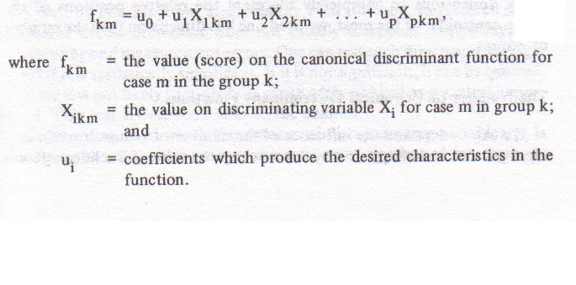
DERIVING THE CANONICAL DISCRIMINANT FUNCTION
A canonical discriminant function is a linear combination of the discriminating variables (IVs), and follows the general linear model

Slide 16
DERIVING THE CANONICAL DISCRIMINANT FUNCTION
We derive the coefficients such that groups will have the greatest mean difference on that function
We can derive other functions that may also distinguish between the groups (less so) but which will be uncorrelated with the first function
The number of functions to be derived is the lesser of k-1 or the DVs
  As we did with MANOVA think of it as cancorr with a dummy coded grouping variable

Slide 17
SPATIAL INTERPRETATION
We can think of our variables as axes that define a N-dimensional space
Each case is a point in that space with coordinates that are the case’s value on the variables
  Form a cloud or swarm of data
So while the groups might overlap somewhat, their territory is not identical, and to summarize the position of the group we can refer to its centroid
  Where the means on the variables for that group meet

Slide 18
Simple example with two groups and 2 vars
Var #2
Var #1
Plot each participant’s position in this “2-space”, keeping track of group membership. Mark each group’s “centroid”

Slide 19
Look at the group difference on each variable, separately.
Var #2
Var #1
The dash/dot lines show the mean difference on each variable

Slide 20
The ldf is “positioned” to maximize the difference between the groups
Var #2
Var #1
In this way, two variables can combine to show group differences

Slide 21
SPATIAL INTERPRETATION
If more possible axes (functions) exist (i.e. situation with more groups and more DVs) we will select those that are independent (perpendicular to the previously selected axis)

Slide 22
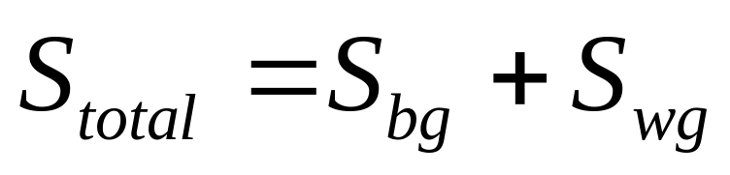
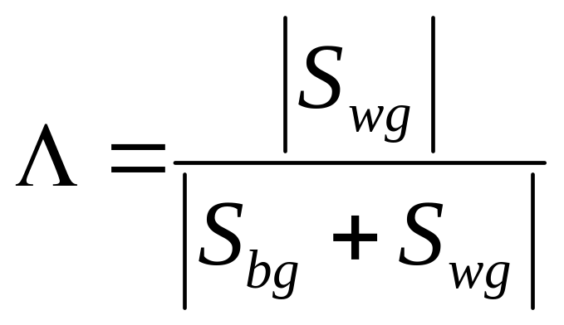
EQUATIONS
To get our results we’ll have to use those same SSCP matrices as we did with Manova

Slide 23
ASSESSING DIMENSIONS (DISCRIMINANT FUNCTIONS)
If the overall analysis is significant than most likely at least the first* function will be worth looking into
With each eigenvalue extracted most programs display the percent of between groups variance accounted for by each function.
Once the functions are calculated each subject is given a discriminant function score
  These scores are then used to calculate correlations between the variables and the discriminant scores for a given function (loadings)
Notes:
*As it is the same as MANOVA, the number of functions equal the lesser of (k-1) groups or predictors.

Slide 24
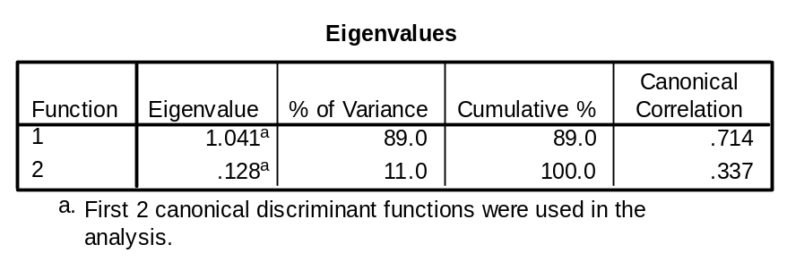
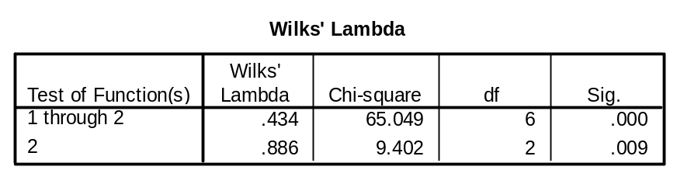
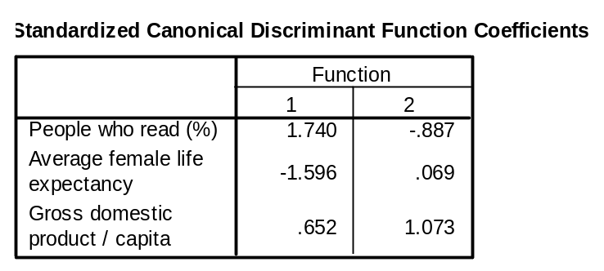
STATISTICAL INFERENCE
World data
  Predicting dominant religion for country*
A canonical correlation is computed for each discriminant function and it is tested for significance as we have in the past
As the math is the same with Manova, we can evaluate the overall significance of a discriminant function analysis
  The same test as for MANOVA and Cancorr
Choices between Wilks’ Lambda, Pillai’s Trace, Hotelling’s Trace and Roy’s Largest Root are the same as when dealing with MANOVA if you prefer those
  Wilks’ is the output in SPSS discriminant analysis via the menu, but as mentioned we can use the Manova procedure in syntax to obtain output for both Manova and DFA
Notes:
*I did this only for the 3 major religious classifications of Catholic Protestant and Islamic.

Slide 25
INTERPRETING DISCRIMINANT FUNCTIONS
Discriminant function plots – interpret how the functions separate the groups
A visual approach to interpreting the dicriminant functions is to plot each group centroid in a two dimensional plot with one function against another function.
If there are only two functions and they are both statistically and practically interesting, then you put Function 1 on the X axis and Function 2 on the Y axis and plot the group centroids.

Slide 26
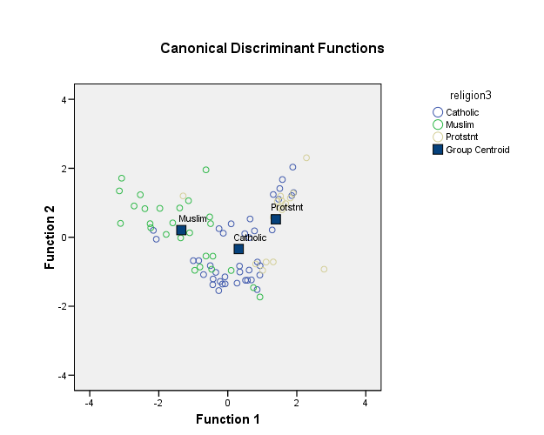
2 FUNCTION PLOT
Notice how the first function we see all 3 groups distinct
Though much less so, they may be distinguishable on function 2 also
Note that for a one function situation we could inspect the histograms for each group along function values

Slide 27
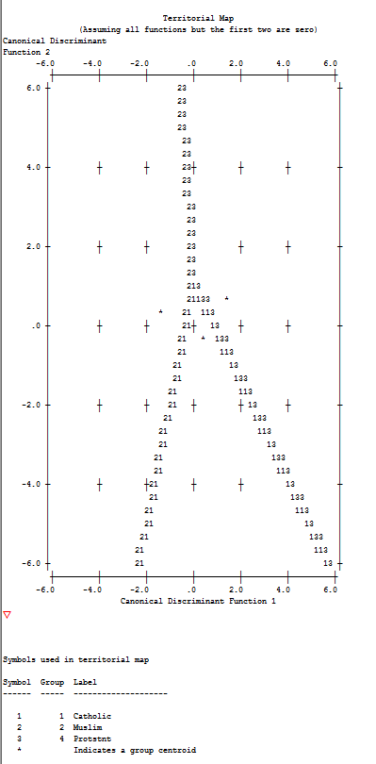
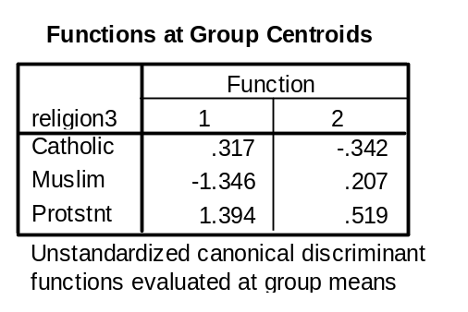
TERRITORIAL MAPS
Provide a picture (absolutely hideous in SPSS) of the relationship between predicted group and two discriminant functions
Asterisks are group centroids
This is just another way in which to see the previous graphic but with how cases would be classified given a particular score on the two functions

Slide 28
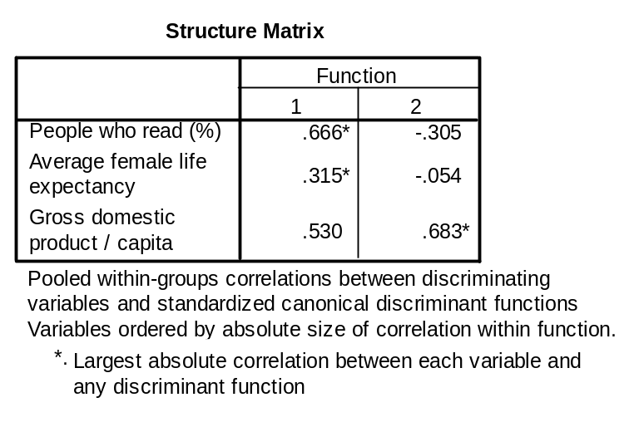
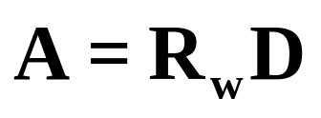
LOADINGS
Loadings (structure coefficients) are the correlations between each predictor and a function.
The squared loading tells you how much variance of a variable is accounted for by the function
Function 1: perhaps representative of ‘country affluence’ (positive correlations on all)
Function 2: Seems mostly related to GDP
A is the loading matrix, R_{w} is the within groups correlation matrix, D is the standardized discriminant function coefficients.

Slide 29
CLASSIFICATION
As mentioned previously, the primary goal in DFA may be geared more towards classification
Classification is a separate procedure in which the discriminating variables (or functions) are used to predict group membership
  Up to this point DFA was indistinguishable from MANOVA
In such a situations, we are not so interested in how the variables perform individually per se, but how well as a set they classify cases according to the groups
  Prediction over explanation

Slide 30
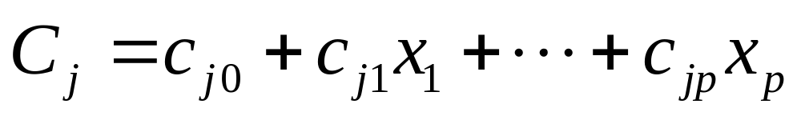
EQUATIONS
Classification score for group j is found by multiplying the raw score on each predictor (x) by its associated classification function coefficient (c_{j}), summing over all predictors and adding a constant, c_{j0}
Note that these are not the same as our discriminant function coefficients
  See mechanics notes

Slide 31
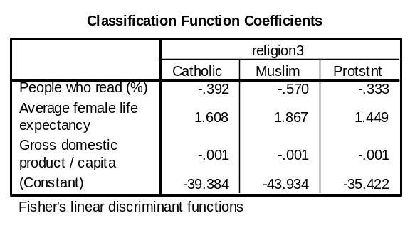
As you can see each group will have a unique set of coefficients and each case will have a score for each group
Whichever one of the groups is associated with the highest classification score is the one the case is classified as belonging to

Slide 32
ALTERNATIVE METHODS
1. Calculate a Mahalnobis’ distance for each case from a groups’ centroid, and classify it in the group it’s closest to
  Would result in a similar outcome as the regular method, though might be useful also in detecting an outlier that is not close to any centroid
2. One could also use discriminant scores rather than our original variables (replace the xs with fs)
  Will generally yield identical results but may not under cases of heterogeneity of variance-covariance matrices or when one of the functions is ignored due non-statistical/practical significance
    In this case classification will probably be more accurate as idiosyncratic variation is removed

Slide 33
PROBABILITY OF GROUP MEMBERSHIP
We can also obtain the probability that a case would belong to each group
  Sum to 1 across groups
It is actually based on Mahalanobis’ distance (which is distributed as a chi-square with p df) so we can use its distributional properties to assess the probability of that particular case’s value/distance

Slide 34
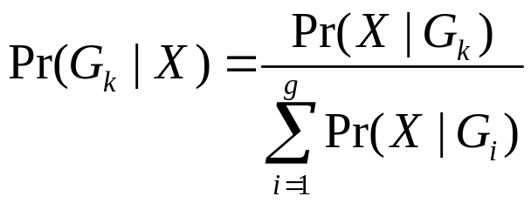
PROBABILITY OF GROUP MEMBERSHIP
Of course it would also have some probability, however unlikely, of every group. So we assess it’s likelihood for a particular group in terms of its probability for belonging to all groups
For example, in a 3 group situation, if a case was equidistant from all group centroids and its value had an associated probability of .25 for each:
  .25/(.25+.25+.25) = .333 probability of belonging to any group (as we’d expect)
If it was closer to one such that
  .5/(.5+.25+.25) = .5 for that group and
  .25/(.5+.25+.25) = .25 for the others

Slide 35
PRIOR PROBABILITY
What we’ve just discussed involves posterior probabilities regarding group membership
However, we’ve been treating the situation thus far as though the likelihood of the groups is equal in the population
What if this is obviously not the case?
  E.g. diagnosis of normal vs depressed
We also might have a case where the cost of misclassification is high
  AIDS, tumor etc.
This involves the notion of prior probability

Slide 36
EVALUATING CLASSIFICATION
How good is the classification?
Classification procedures work well when groups are classified at a percentage higher than that expected by chance
This chance classification depends on the nature of the membership in groups

Slide 37
EVALUATING CLASSIFICATION
If the groups are not equal than there are a couple of steps
Calculate the expected probability for each group relative to the whole sample.
  For example if there are 60 subjects; 10 in group 1, 20 in group 2 and 30 in group three, then the percentages are .17, .33 and .50.
    Prior probabilities
The computer program* will then attempt to assign 10, 20 and 30 subjects to the groups.
  In group one you would expect .17 by chance or about 2,
  in group two you would expect .33 or about 6 or 7
  and in group 3 you would expect .50 or 15 would be classified correctly by chance alone.
  If you add these up 1.7 + 6.6 + 15 you get 23.3 (almost 40%) cases total would be classified correctly by chance alone.
  So you hope that you classification works better than that.
Notes:
*Note: This is for an example only. Do not use your data to assess prior probabilities. Use other research or known population values, otherwise you run the risk of lack of generalizability.

Slide 38
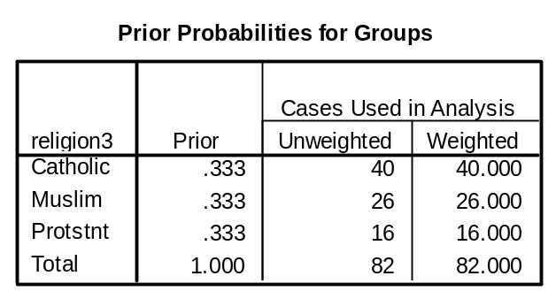
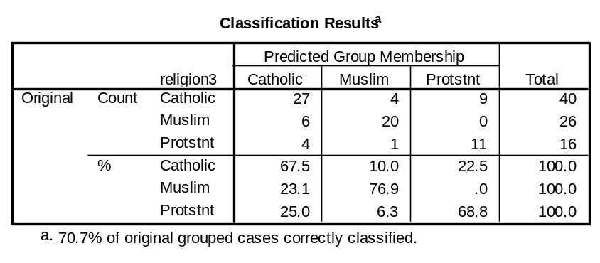
CLASSIFICATION OUTPUT
Without assigning priors, we’d expect classification success of 33% for each group by simply guessing
  And actually by world population they aren’t that far off with roughly a billion members each
Classification coefficients for each group
The results:
  Not too shabby 70.7% (58 cases) correctly classified

Slide 39
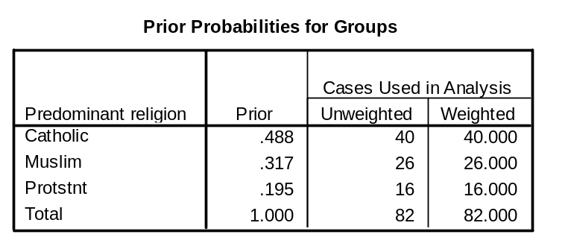
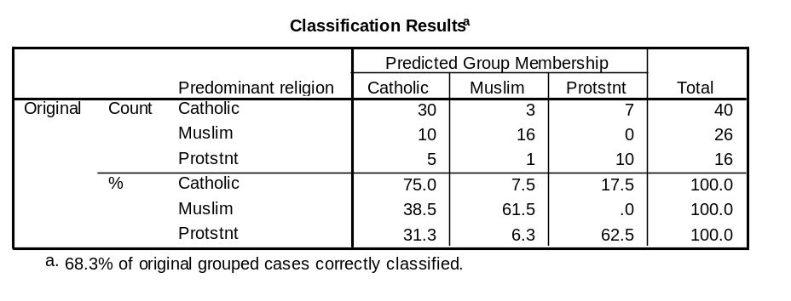
OUTPUT BASE ON PRIORS
Just an example for prior probabilities.
Overall classification is actually worse
Another way of assessing your results is, knowing there were more Catholics (41/84 i.e. not just randomly guessing), my overall classification would be 49% if I just classified everything as Catholic
Is 68% overall rate a significant improvement (practically speaking) compared to that?

Slide 40
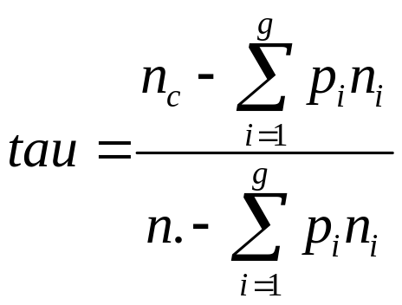
EVALUATING CLASSIFICATION
One can actually perform a test of sorts on the overall classification
n_{c} = number correctly classified
p_{i} = prior probability of membership
N_{i} = number of cases for that group
N. = total n

Slide 41
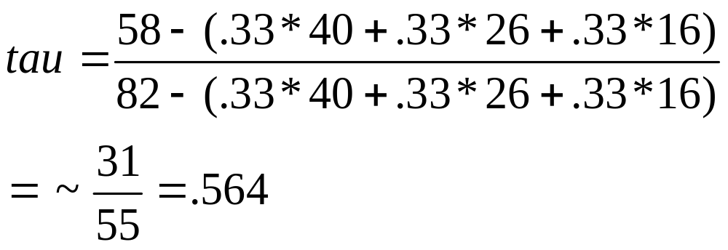
In the informed situation
This ranges from 0 – 1 and can be interpreted as the percentage fewer errors compared to random classification

Slide 42
OTHER MEASURES REGARDING CLASSIFICATION
Measure | Calculation
Prevalence | (a + c)/N
Overall Diagnostic Power | (b + d)/N
Correct Classification Rate | (a + d)/N
Sensitivity | a/(a + c)
Specificity | d/(b + d)
False Positive Rate | b/(b + d)
False Negative Rate | c/(a + c)
Positive Predictive Power | a/(a + b)
Negative Predictive Power | d/(c + d)
Misclassification Rate | (b + c)/N
Odds-ratio | (ad)/(cb)
Kappa | (a + d) - (((a + c)(a + b) + (b + d)(c + d))/N) N - (((a + c)(a + b) + (b + d)(c + d))/N)
NMI n(s) | 1 - -a.ln(a)-b.ln(b)-c.ln(c)-d.ln(d)+(a+b).ln(a+b)+(c+d).ln(c+d) N.lnN - ((a+c).ln(a+c) + (b+d).ln(b+d))
 | Actual + | Actual -
Predicted + | a | b
Predicted - | c | d

Slide 43
EVALUATING CLASSIFICATION
Cross-Validation
With larger datasets one can also test the classification performance using cross validation techniques we’ve discussed in the past
Estimate the classification coefficients for one part of the data and then apply the coefficients to the other to see if they perform similarly
This allows you to see how well the classification generalizes to new data
In fact, for PDA, methodologists suggest that this is the way one should be doing it period i.e. that the classification coefficients used are not derived from the data to which they are applied

Slide 44
TYPES OF DISCRIMINANT FUNCTION ANALYSIS
As DFA is analogous to multiple regression, we have the same options for variable entry
Simultaneous
  All predictors enter the equation at the same time and each predictor is credited for its unique variance
Sequential (hierarchical)
  Predictors are given priority in terms of its theoretical importance,
  User defined approach.
  Can be used to assess a set of predictors in the presence of covariates that are given highest priority.
Stepwise (statistical) – this is an exploratory approach to discriminant function analysis.
  Predictors are entered (or removed) according to statistical criterion.
  This often relies on too much of the chance variation that does not generalize to other samples unless some validation technique is used.

Slide 45
DESIGN COMPLEXITY
Factorial DFA designs
Really best to just analyze through MANOVA
  Can you think of a reason to classify an interaction?
However this is done in two steps
  Evaluate the factorial MANOVA to see what effects are significant
  Evaluate each significant effect through discrim
If there is a significant interaction then the DFA is run by combining the groups to make a one way design
  (e.g. if you have gender and IQ both with two levels you would make four groups high males, high females, low males, low females)
  If the interaction is not significant then run the DFA on each main effect separately for loadings etc.
  Note that it will not produce the same results as the MANOVA would

Slide 46
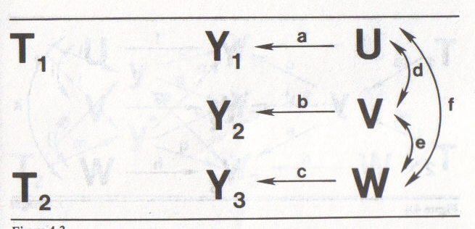
THE CAUSAL APPROACH: A SUMMARY OF DFA
Recall our discussion of Manova

Slide 47
THE CAUSAL APPROACH
The null hypothesis regarding a 3 group (2 dummy variable) situation. No causal link between the grouping variable and the set of continuous variables.

Slide 48
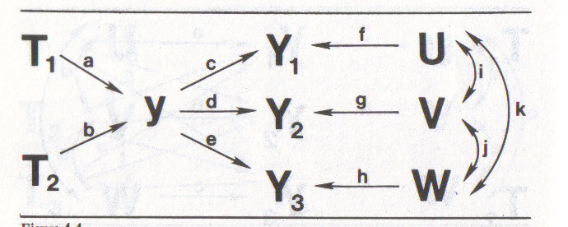
THE CAUSAL APPROACH
The original continuous variables are linearly combined in DFA to form y
This can also be seen as the Ys being manifestations of the construct represented by y, which the groups differ on

Slide 49
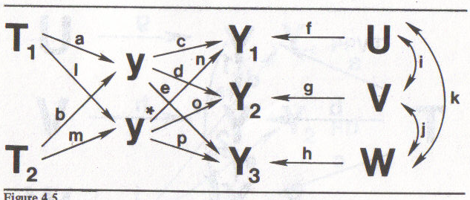
THE CAUSAL APPROACH
It may be the case that the groups differ significantly upon more than one dimension (factor) represented by the Ys
Another combination (y*), in this case one uncorrelated with y is necessary to explain the data

